Slide 1
AN EFFECTIVE TEXT SUMMARIZATION USING NATURAL LANGUAGE PROCESSING
Batch No :11
Under the guidance of:
Mr.B.R.S.S.Raju, MCA, M.Tech
Asst. Prof
Department of CSE
Aditya Engineering College (A)
Team Members:
APARNA ALAMANDA (16A91A05C4)
HIMASRI SATHI (16A91A05H0)
SAI PRADEEP BODDU (16A91A05C7)
NAGENDRA TETAKALE (16A91A05H5)

Slide 2

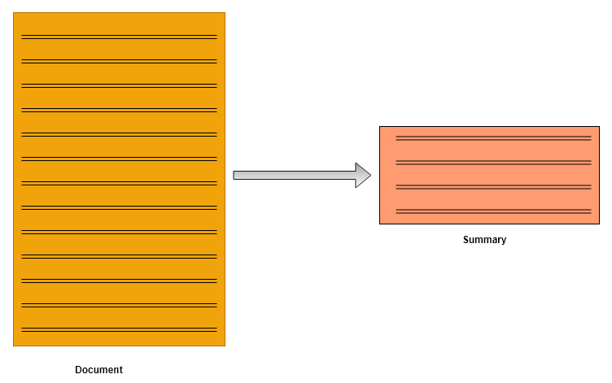
Abstract
Aditya Engineering College (A)
Text Summarization is a technique that shortens a long piece of text in internet with main points outlined that gives an idea of the whole content. It becomes critical when someone needs a quick and accurate summary of very long content. Summarizing text can be expensive and time-consuming if done manually.
Natural Language Processing is helpful in creating an automatic text summary and web scrapping is helpful to extract data from websites in internet.
Batch-11
An Effective Text Summarization using Natural Language Processing

Slide 3

Existing System
Aditya Engineering College (A)
Internet contain huge amount of information which may be redundant or insignificant to users. Users have to go through the content of every website manually, put in a lot of effort to understand and summarize it in their own words.
Batch-11
An Effective Text Summarization using Natural Language Processing

Slide 4
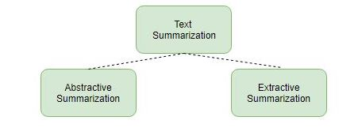
Proposed System
Aditya Engineering College (A)
The proposed system of text summarization technique enhances the readability of text in internet websites and reduces the time spent in researching for information
This system makes use of two approaches to summarize texts:
-Extractive summarization
-Abstractive summarization
Batch-11
An Effective Text Summarization using Natural Language Processing

Slide 5
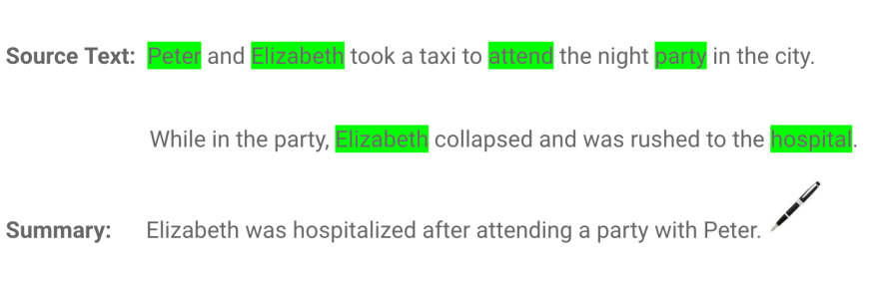
Continuation
Aditya Engineering College (A)
Abstractive summarization:
In abstractive summarization is applied to paraphrase and shorten the original document, just like humans do. can generate new phrases and sentences that represent the most important information from the source text without grammatical inaccuracies.
Batch-11
An Effective Text Summarization using Natural Language Processing

Slide 6
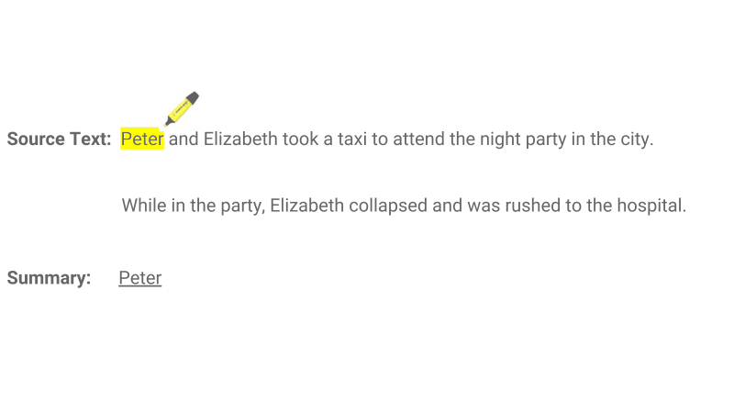
Continuation
Aditya Engineering College (A)
Extractive summarization:
In this, a subset of words that represent most important points is pulled from a text document and combined to make a summary
Batch-11
An Effective Text Summarization using Natural Language Processing

Slide 7
System Configuration
Aditya Engineering College (A)
HARDWARE REQUIREMENTS:
Processor - Intel Pentium-II or higher
RAM - 128MB or higher
Hard Disk - 20GB or higher
Key Board - Standard Windows Keyboard
Mouse - Two or Three Button Mouse
Monitor - LCD/LED
SOFTWARE REQUIREMENTS:
Operating System - Windows XP or higher
Coding Language - Python(v 3.8)
Technology - Machine Learning and Natural Language processing
Batch-11
An Effective Text Summarization using Natural Language Processing

Slide 8




Packages
Aditya Engineering College (A)
Batch-11
An Effective Text Summarization using Natural Language Processing

Slide 9
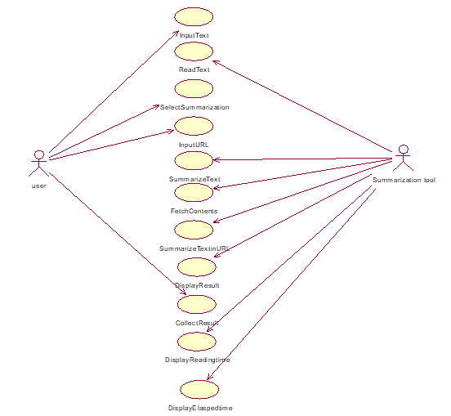
Usecase Diagram
Aditya Engineering College (A)
Batch-11
An Effective Text Summarization using Natural Language Processing

Slide 10
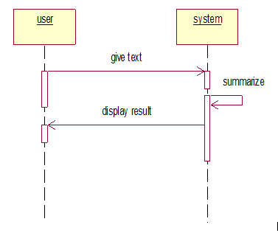
Sequence Diagram
Aditya Engineering College (A)
Sequence diagram to summarize text given
Batch-11
An Effective Text Summarization using Natural Language Processing

Slide 11
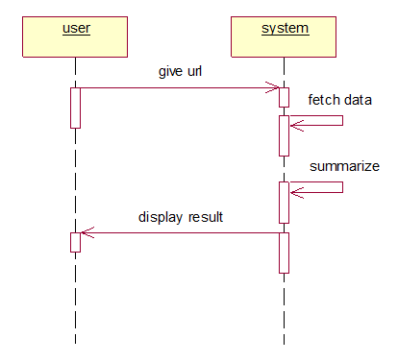
Sequence Diagram
Aditya Engineering College (A)
Sequence diagram to summarize text in the website of given url.
Batch-11
An Effective Text Summarization using Natural Language Processing

Slide 12
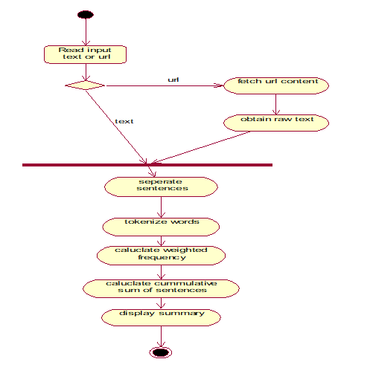
Activity Diagram
Aditya Engineering College (A)
Batch-11
An Effective Text Summarization using Natural Language Processing

Slide 13
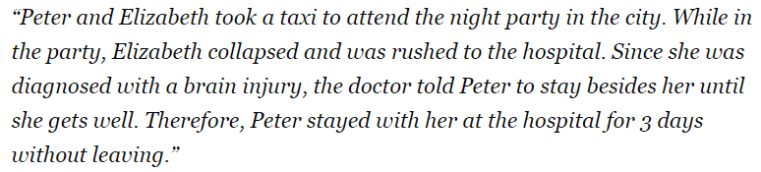
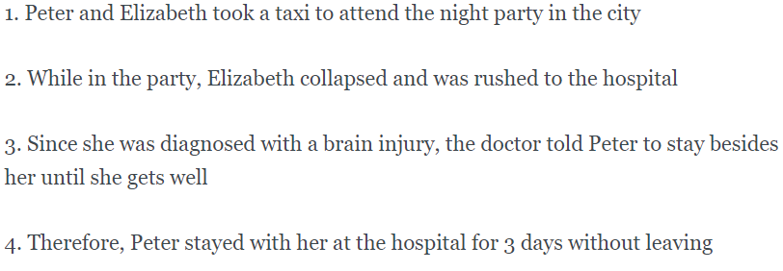
Text Summarization Algorithm
Aditya Engineering College (A)
1. Convert the paragraph into sentences.
Batch-11
An Effective Text Summarization using Natural Language Processing

Slide 14
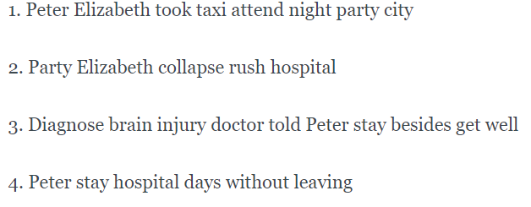
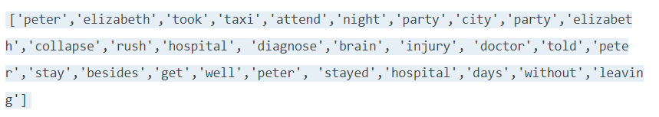
Continuation
Aditya Engineering College (A)
Process the text by removing stop words.
Tokenize the sentences to get all the words present in the sentences.
Batch-11
An Effective Text Summarization using Natural Language Processing

Slide 15
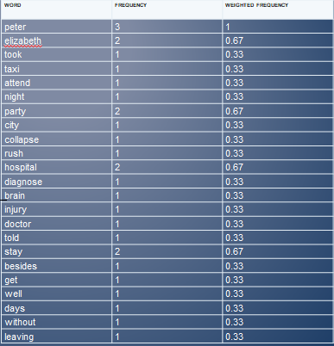

Continuation
Aditya Engineering College (A)
Evaluate weighted frequency of each word based on it’s occurrence.
Frequency of each word is
calculated and then
where i=1,2,3… and fm is
frequency of most repeated
word
Batch-11
An Effective Text Summarization using Natural Language Processing

Slide 16
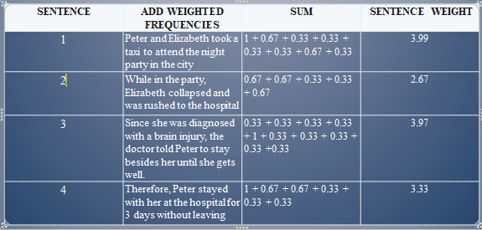
Continuation
Aditya Engineering College (A)
Calculate cumulative sum of each sentence by
substituting the word’s weighted frequencies.
Batch-11
An Effective Text Summarization using Natural Language Processing

Slide 17


Sample Code
Aditya Engineering College (A)
Code to fetch text from url
Code to pre process raw text
Batch-11
An Effective Text Summarization using Natural Language Processing

Slide 18
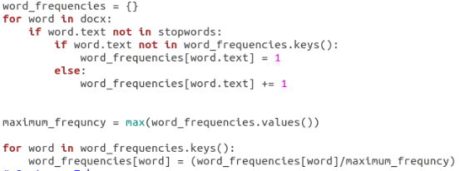
Sample Code
Aditya Engineering College (A)
Code to calculate word frequencies.
Batch-11
An Effective Text Summarization using Natural Language Processing

Slide 19
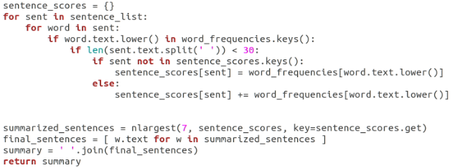
Sample Code
Aditya Engineering College (A)
Code to calculate sentence score.
Batch-11
An Effective Text Summarization using Natural Language Processing

Slide 20
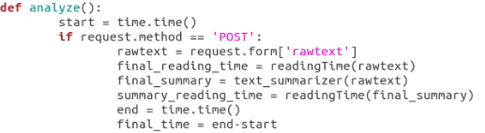

Sample Code
Aditya Engineering College (A)
Code to anaylze text from webpage and calculate elasped time.
Code to calculate reading time.
Batch-11
An Effective Text Summarization using Natural Language Processing

Slide 21
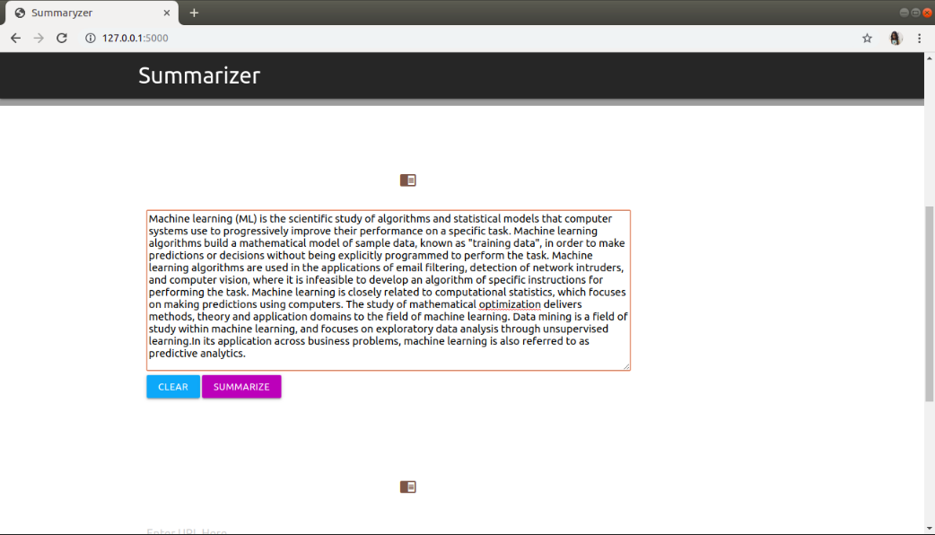
Text Input
Aditya Engineering College (A)
Batch-11
An Effective Text Summarization using Natural Language Processing

Slide 22
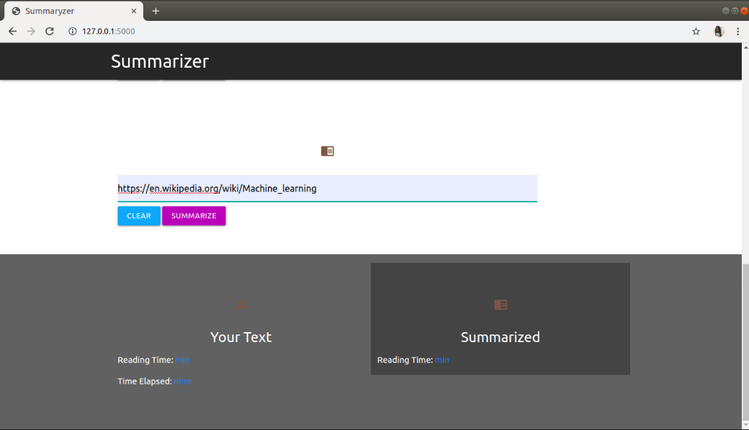
URL Input
Aditya Engineering College (A)
Batch-11
An Effective Text Summarization using Natural Language Processing

Slide 23
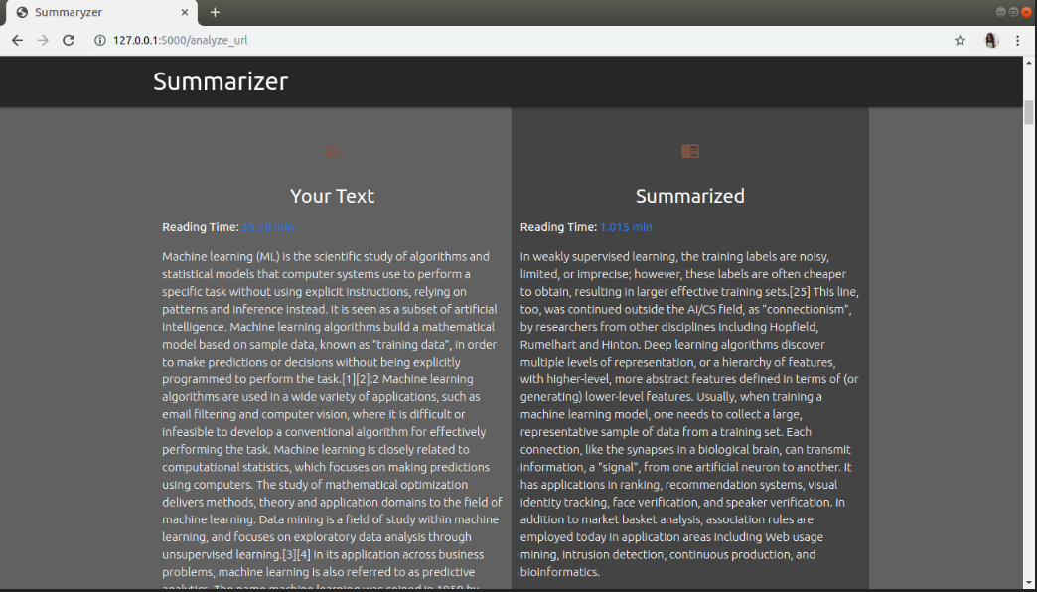
Result Screen
Aditya Engineering College (A)
Batch-11
An Effective Text Summarization using Natural Language Processing

Slide 24
1. Selvani Deepthi Kavila and Dr.Radhika Y, “Extractive Text Summarization Using Modified Weighing and Sentence Symmetric Feature”, I.J. Modern Education and Computer Science, October 2015.
2. Karel Jezek and Josef Steinberger, “Automatic Text summarization”, Vaclav Snasel (Ed.): Znalosti 2008, Ustav Informatiky a softveroveho inzinierstva, pp.1-12, 2008.
3. S.Mohamed Saleem, R.Krithiga, S.K.Rani, S.Celin Sindhya, “Study on text summarization using extractive methods”, International Journal of Science, Engineering and Technology Research (IJSETR), Volume 4, Issue 5, May 2015.
References
Aditya Engineering College (A)
Batch-11
An Effective Text Summarization using Natural Language Processing

Slide 25
In this new age, where massive amount of data is present digitally, it is essential to have a mechanism like Automatic Text Summarization in order to overcome the problem of information overload which has been growing rapidly. The process of text summarization summarizes the text with the help of Python NLTK library.
Conclusions
Aditya Engineering College (A)
Batch-11
An Effective Text Summarization using Natural Language Processing

Slide 26

Any Queries?
Aditya Engineering College (A)
Batch 11- An Effective Text Summarization using Natural Language Processing

Slide 27

Aditya Engineering College (A)
Batch-11
An Effective Text Summarization using Natural Language Processing

